Slide 1
Apache Spark Introduction
CS143 Project 2 Background
Notes:
Slides courtesy of Jiaqi Guo

Slide 2
Keep Following Things in mind
Start Project 2 as early as possible! (Deadline: Dec. 8th. Friday of 10th week)
Read Project Description Carefully!
Many new concepts to learn by yourself.
Scala, RDD, Query Plans/Operators, UDFs, etc
Setting up the Spark Dev Environment
Getting familiar with code skeleton we provided and related Spark SQL code
Focus on Task 1-5, and check Piazza for Q&A.
After you finish first 5 tasks, you can try task 6, 7
Designed for students who want more challenges ☺

Slide 3
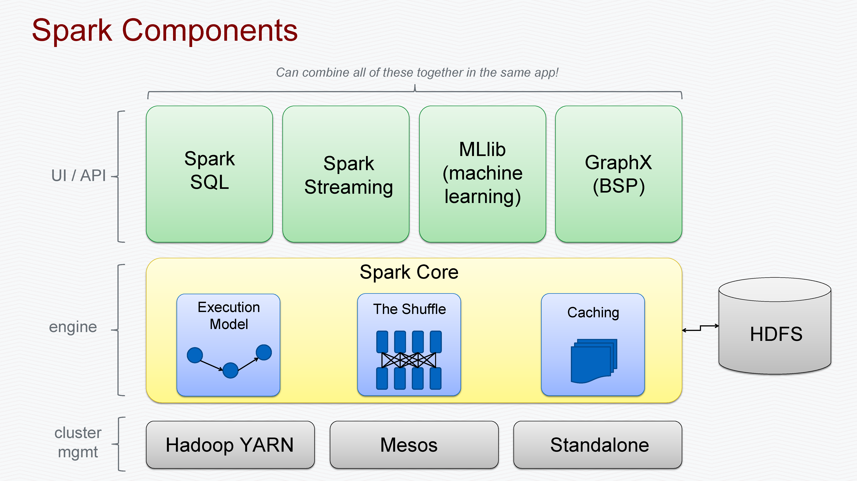
Slide taken from: https://www.slideshare.net/thelabdude/apachecon-na-2015-spark-solr-integration
Notes:
Spark Core is the base of an overall spark project.
It is responsible for distributed task dispatching, parallelism, scheduling, and basic I/O functionalities.
All the basic functionality of spark core are exposed through an API (for Java, Python, Scala, and R) centered on the RDD abstraction.

Slide 4
Resilient Distributed Datasets (RDD) (Key Abstraction of Data Parallelization in Spark)
RDD is an immutable (read-only) distributed collection of records.
Each dataset in RDD is divided (partitioned) into logical partitions, which may be computed on different nodes of the cluster.
RDDs can be created through operations such as map, filter or reduce on either data on stable storage or other RDDs.
RDD is a fault-tolerant collection of elements that can be operated on in parallel.
RDD is represented by various RDD objects in Spark.

Slide 5
RDD Example (Word count)
Spark Program typically starts with the creation of an RDD for data reading (e.g. HadoopRDD)
User specifies a series of transformations (e.g. map, reduce, groupBy) on exisitng RDDs to create new RDDs.
Until an action (e.g. count, collect, save) is called, the RDD DAG gets analyzed and optimized, delivered to worker nodes for execution. (Lazy Evaluation)
// HadoopRDD created
val file = spark.textFile(“hdfs://...”)
// FlatMappedRDD, MappedRDD, ShuffledRDD created
val counts = file.flatMap(line => line.split(“ ”)) .map(word => (word, 1))
.reduceByKey(_ + _)
// Only until an RDD is called, the DAG gets executed in parallel
counts.saveAsTextFile(“hdfs://...”)
Slide taken from: https://www.slideshare.net/thelabdude/apachecon-na-2015-spark-solr-integration

Slide 6
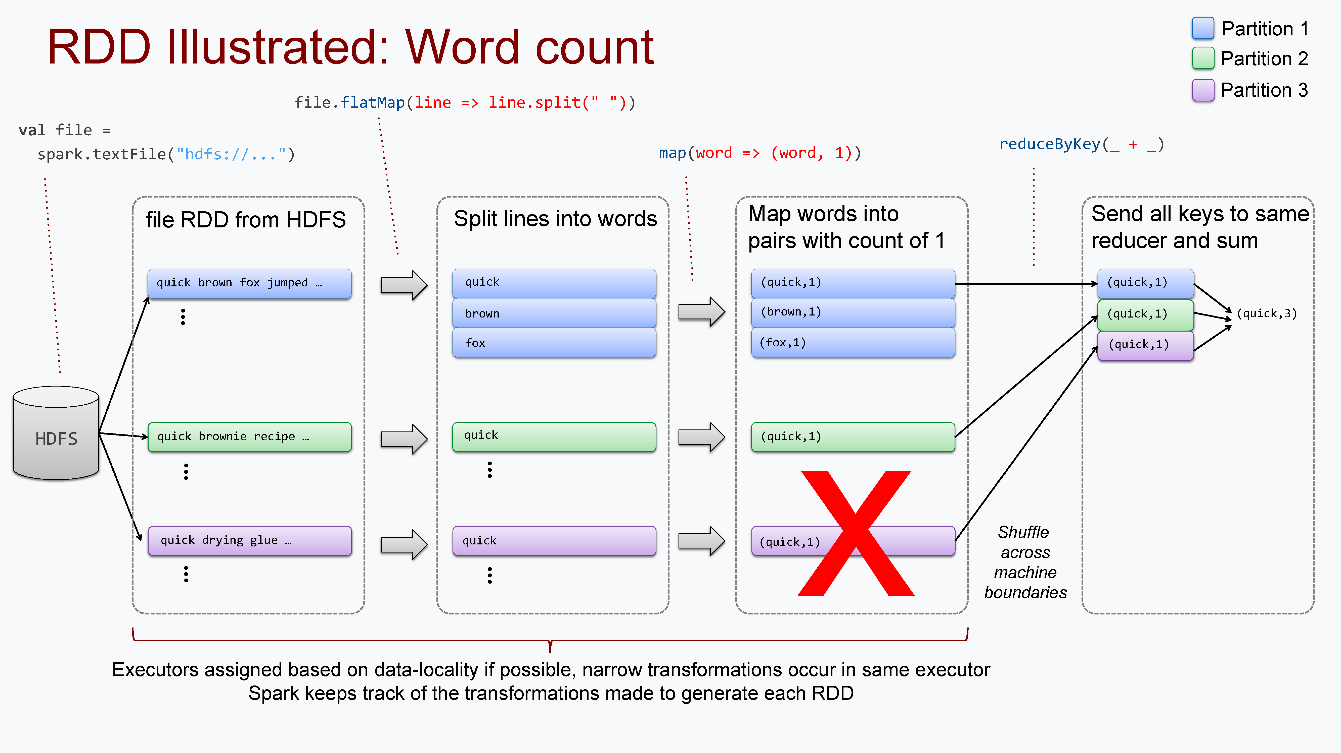
Slide taken from: https://www.slideshare.net/thelabdude/apachecon-na-2015-spark-solr-integration

Slide 7
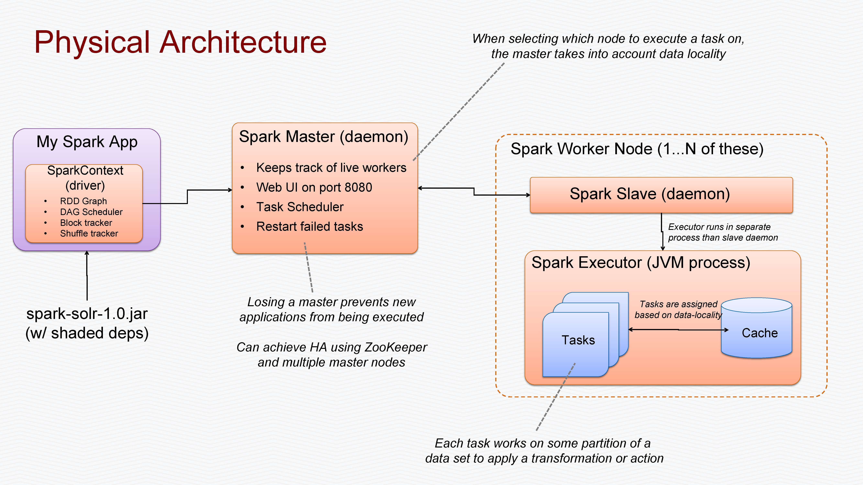
In our project, we will not touch the distributed deployment (cluster). All Master/Slaves run as separate processes on the same machine!
Slide taken from: https://www.slideshare.net/thelabdude/apachecon-na-2015-spark-solr-integration

Slide 8
Spark SQL / DataFrame
Spark SQL is a Spark module for structured data processing. It provides a programming abstraction called DataFrames and can also act as distributed SQL query engine.
A DataFrame (RDD + Schema) is a distributed collection of data organized into named columns. It is conceptually equivalent to a table in a relational database or a data frame in R/Python, but with richer optimizations under the hood.
DataFrames can be constructed from a wide array of sources such as: structured data files, tables in Hive, external databases, or existing RDDs.

Slide 9
DataFrame Operations
val sc: SparkContext // An existing SparkContext.
val sqlContext = new org.apache.spark.sql.SQLContext(sc)
// Create the DataFrame
val df = sqlContext.jsonFile("examples/src/main/resources/people.json")
// Show the content of the DataFrame
df.show()
// age name
// null Michael
// 30 Andy
// 19 Justin
// Print the schema in a tree format
df.printSchema()
// root
// |-- age: long (nullable = true)
// |-- name: string (nullable = true)
// Select only the "name" column
df.select("name").show()
// name
// Michael
// Andy
// Justin
// Select everybody, but increment the age by 1 df.select("name", df("age") + 1).show()
// name (age + 1)
// Michael null
// Andy 31
// Justin 20
// Select people older than 21
df.filter(df("name") > 21).show()
// age name
// 30 Andy
// Count people by age
df.groupBy("age").count().show()
// age count
// null 1
// 19 1
// 30 1
Notes:
DataFrames provide a domain-specific language for structured data manipulation in Scala, Java, and Python.
Here we include some basic examples of structured data processing using DataFrames:

Slide 10
DataFrame, SchemaRDD, SQL
// sc is an existing SparkContext.
val sqlContext = new org.apache.spark.sql.SQLContext(sc)
// this is used to implicitly convert an RDD to a DataFrame.
import sqlContext.implicits._
// Define the schema using a case class.
case class Person(name: String, age: Int)
// Create an RDD of Person objects and register it as a table.
val people = sc.textFile("examples/src/main/resources/people.txt")
.map(_.split(",")).map(p => Person(p(0), p(1).trim.toInt)).toDF()
people.registerTempTable("people")
// SQL statements can be run by using the sql methods provided by sqlContext.
val teenagers = sqlContext.sql("SELECT name FROM people WHERE age >= 13 AND age <= 19")
// The results of SQL queries are DataFrames and support all the normal RDD operations.
// The columns of a row in the result can be accessed by ordinal.
teenagers.map(t => "Name: " + t(0)).collect().foreach(println)
Notes:
The Scala interface for Spark SQL supports automatically converting an RDD containing case classes to a DataFrame. The case class defines the schema of the table. The names of the arguments to the case class are read using reflection and become the names of the columns. Case classes can also be nested or contain complex types such as Sequences or Arrays. This RDD can be implicitly converted to a DataFrame and then be registered as a table. Tables can be used in subsequent SQL statements.

Slide 11
Project 2 Related
Skeleton codes: CS143Utils, basicOperators, DiskHashedRelation
Some useful functions are already contained in CS143Utils and DiskHashedRelation. (Understand them and save time!)
Other useful files: Aggregate.scala, SparkPlan.scala, basicOperators.scala
Majority of code you need to look at is contained in the package: sql/core/src/main/scala/org/apache/spark/sql/execution

Slide 12
Iterator Interface
Iterator provides an interface to collections that enforces a specific API: the next and hasNext functions.
Some tasks ask you to implement the function to generate a new iterator given an iterator as the argument.
def generateIterator(args): (Iterator[Row] => Iterator[Row]) = {
/* Type of input is Iterator[Row] */ input => { new Iterator[Row] { /* Use input.next and input.hasNext to help implement the new iterator */
def hasNext() => …
def next() => …
} } }

Slide 13
